Slide 1

Chapter 9
Social Groups and Social Stratification
Notes:
For a better classroom presentation flow, the order of some topics in this lecture outline differs slightly from the order of topics in the text and, where this occurs, some figures and tables are out of numerical order.

Slide 2
Learning Objectives
9.1 Explain what social groups are.
9.2 Define what is included in the term social stratification.
9.3 Discuss the concept of civil society.

Slide 3
Social Groups (1 of 4)
9.1 Explain what social groups are.
Friendship
Clubs and Fraternities/Sororities
Cooperatives
Self-Help Groups

Slide 4
Social Groups (2 of 4)
What is a social group?
  A cluster of people beyond the domestic unit who are usually related to each other on grounds other than kinship

Slide 5
Social Groups (3 of 4)
Two kinds of social groups:
  Primary social group: people who interact with each other and know each other personally
  Secondary social group: people who identify with each other on some basis but who may never meet each other or know each other personally

Slide 6
Social Groups (4 of 4)
Degrees of formality/informality
Connections to modes of livelihood:
  Foragers have fewer forms of social groups than other modes
  Industrial/digital economy societies have a wide variety, perhaps compensating for less important role of kinship
Example: Grameen Bank in Bangladesh

Slide 7
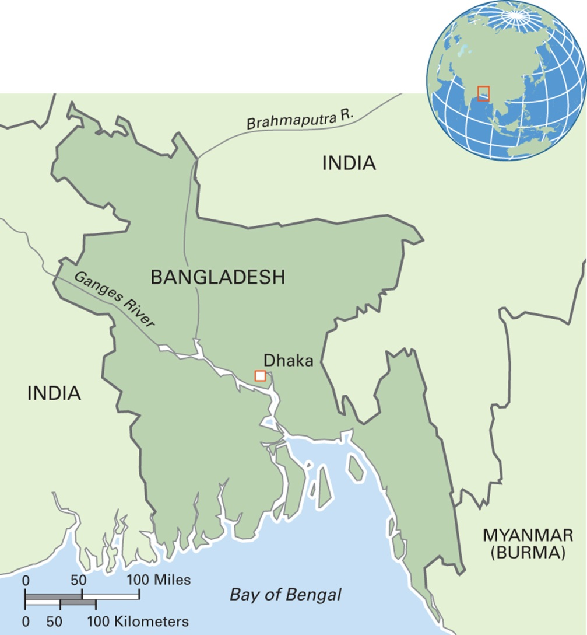
Map 9.1 Bangladesh
Notes:
The People’s Republic of Bangladesh is located on a deltaic floodplain with rich soil and risk of flooding. One of the world’s most densely populated countries, Bangladesh has around 160 million people living in an area about the size of the state of Wisconsin. Bangladesh is the world’s third largest Muslim-majority country and the eighth largest country in the world in terms of population.

Slide 8
Friendship (1 of 2)
What is friendship?
  Close social ties between at least two people, usually informal, voluntary, and, traditionally, involving face-to-face interaction (new communications technology challenges that characteristic)

Slide 9
Friendship (2 of 2)
May contribute to economic security
  Example: research by Carol Stack
Related to microcultural factors: gender, age, class, ethnicity, and institutions
Maintained through balanced exchange
  Example: swapping stories in Guyana
Usually between social equals

Slide 10
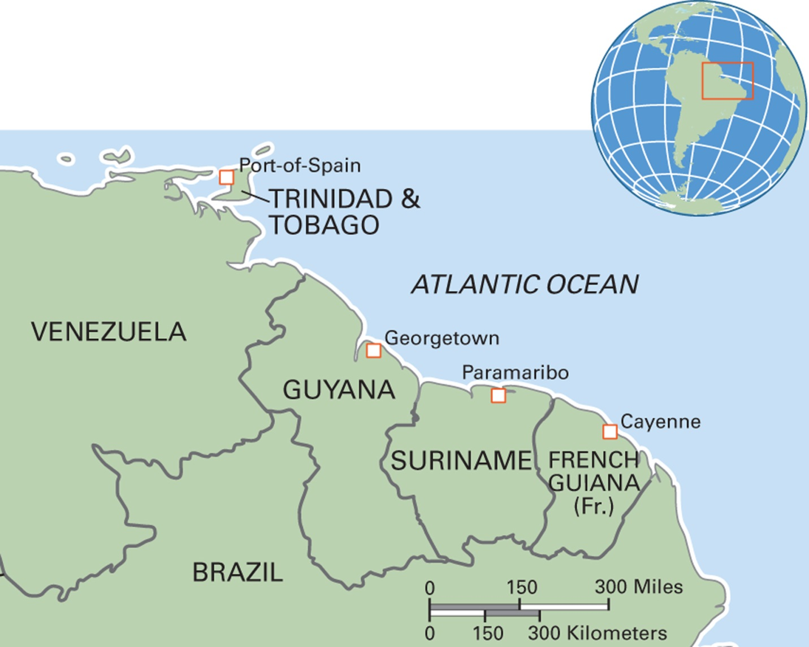
Map 9.2 Caribbean Countries of South America
Notes:
The ethnically and linguistically diverse countries of the Caribbean region of South America include Guyana, Suriname, and French Guiana. Guyana, or the Co-operative Republic of Guyana, is the only South American country whose official language is English. Other languages are Hindi, Wai Wai, and Arawak. Its population is over 700,000. The Republiek Suriname, or Suriname, was formerly a colony of the Netherlands and is the smallest independent state in South America. Its population is 570,000. Dutch is the official language, but most Surinamese also speak Sranan Tongo, or Surinaams, a mixture of Dutch, English, Portuguese, French, and local languages. French Guiana is an overseas department of France and is thus part of the European Union. The smallest political unit in South America, its population is 260,000. Its official language is French, but several other languages are spoken, including indigenous Arawak and Carib.

Slide 11
Think Like an Anthropologist:
Making Friends
In Andalucia, southern Spain, men’s and women’s work roles shape their friendship patterns
For men, an amigo is a casual friend and this friendship is maintained in bars
An amigo(a) de verdad is a “true friend”
Men have more true friends than women do
Food for Thought: What categories of friends do you have? Are friends in some categories “closer” or “truer” than others? What is the basis of close friendship?

Slide 12
Clubs and Fraternities/Sororities (1 of 8)
Definition: social groups that define membership in terms of a sense of shared identity and objectives
Mainly include people of same ethnic heritage
Provide social and psychological support to members but have political and economic functions, too (connections, networking, jobs)

Slide 13
Clubs and Fraternities/Sororities (2 of 8)
College fraternities and sororities in North America (the “Greek system”) are highly selective and serve a variety of functions, such as entertainment, matchmaking, and social service

Slide 14
Clubs and Fraternities/Sororities (3 of 8)
Peggy Sanday’s study of gang rape in U.S. fraternities
  Study of initiation rituals and male bonding in an Ivy League university of the U.S. northeast
  Not characteristic of all U.S. fraternities
  In some, ritual of the “train” in which a woman is gang-raped by the brothers

Slide 15
Clubs and Fraternities/Sororities (4 of 8)
Men’s houses and gynophobia
  Separate “men’s houses” exist in many cultures
  Example: some indigenous Amazonian groups
  Women who look into the men’s house are punished by gang rape
  Interpretation: related to cultures that value male aggressiveness

Slide 16
Clubs and Fraternities/Sororities (5 of 8)
Countercultural groups
  Groups formed by people outside the “mainstream” who resist conforming to the dominant cultural pattern
  Members desire to be identified with a special group
    Youth gangs
    Body modification groups

Slide 17
Clubs and Fraternities/Sororities (6 of 8)
Youth gangs
  Refers to a group of young people found mainly in urban areas
  Often considered to be a social problem by mainstream society
  Variation in terms of how organized and goals
  Most/all have rituals of initiation and symbols of membership such as clothing, “colors,” tattoos
  Example: Masta Liu of Honiara, Solomon Islands

Slide 18
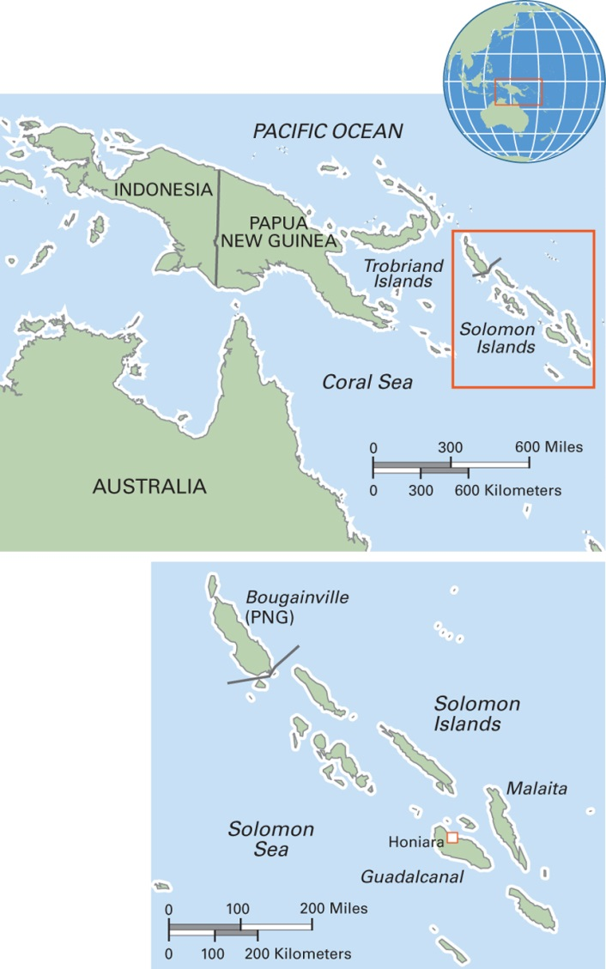
Map 9.3 The Solomon Islands
Notes:
This country consists of nearly 1,000 islands. Its capital, Honiara, is located on the island of Guadalcanal. The population is nearly 600,000. Most of the people earn a living through small-scale farming and fishing. Commercial exploitation of local timber has led to severe deforestation. Over 70 languages are spoken, and an additional four have recently gone extinct. Most people are Christian, mainly Anglican. The Solomons were the site of some of the bitterest fighting during World War II.

Slide 19
Clubs and Fraternities/Sororities (7 of 8)
Study of youth gangs in the United States
  Found that personalities of youth gang members have five characteristics:
    Intense competitiveness
    Mistrust of others
    Self-reliance
    Social isolation
    Strong survival instinct

Slide 20
Clubs and Fraternities/Sororities (8 of 8)
Structurist view of youth gangs:
  Personality characteristics the result of poverty
  Youth gang members join gangs because they want the same things as members of mainstream groups (such as fraternities and sororities), but they do not have access to those legal pathways to success

Slide 21
Cooperatives (1 of 2)
A form of economic group in which surpluses are shared among the members
One person, one vote
Agricultural and credit cooperatives the most common forms worldwide

Slide 22
Cooperatives (2 of 2)
Example: study of cooperatives related to production and sale of molas
  Guna people of Panama
  Helps promote steadier earnings
  Also serves as a consumer’s cooperative

Slide 23
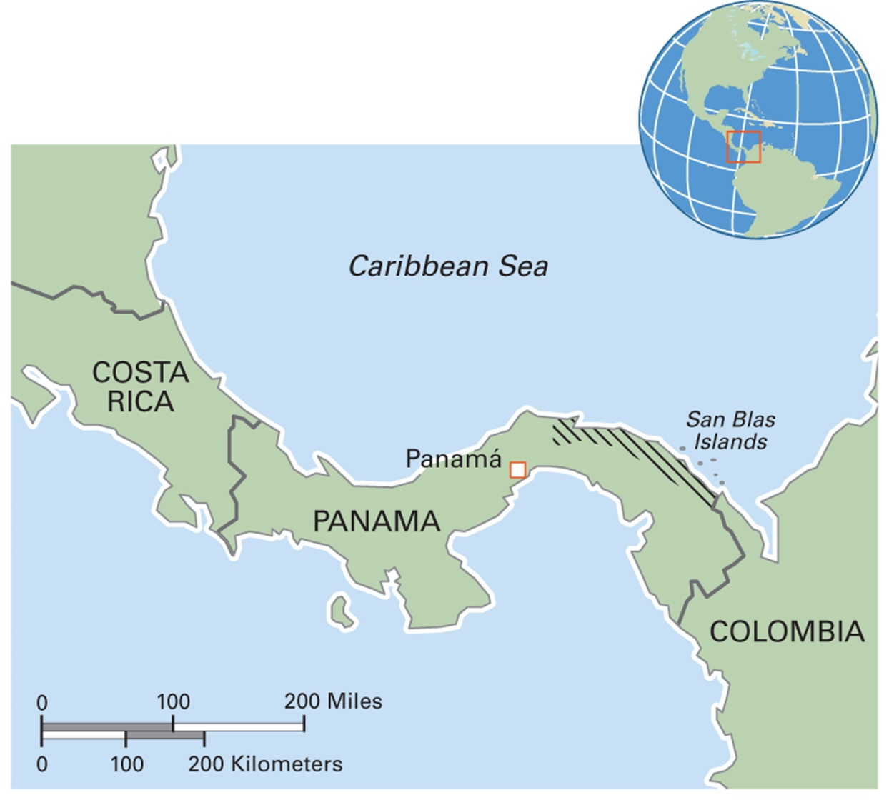
Map 9.4 Guna Region in Panama
Notes:
The Guna are an indigenous people who live mainly in the eastern coastal region of Panama, including its offshore islands. Some live in cities, and a few live in villages in neighboring Colombia. The Guna population is around 150,000. Farming, fishing, and tourism are important parts of the economy. Each community has its own political organization, and the Guna as a whole are organized into the Kuna General Congress. Most speak Guna, or Dulegaya (“People’s Language”), and Spanish. They follow traditional religious practices, often with a mixture of Christian elements.

Slide 24
Self-Help Groups
Formed to achieve personal goals
Varieties and numbers have proliferated in recent years
Rituals of solidarity
Example: study of Alcoholics Anonymous among working-class men in Mexico City

Slide 25
Social Stratification
9.2 Define what is included in the term social stratification.
Status: a person’s (or group’s) position, or standing, in society
Achieved Status: Class
Ascribed Status: “Race,” Ethnicity, Gender, and Caste

Slide 26
Achieved Status: Class (1 of 2)
A person’s or group’s position in society defined in economic terms, as “achieved” by the individual
Examples of class-based groups: labor unions, exclusive clubs
Is class sometimes not achieved, but born into?
U.S. value of meritocratic individualism

Slide 27
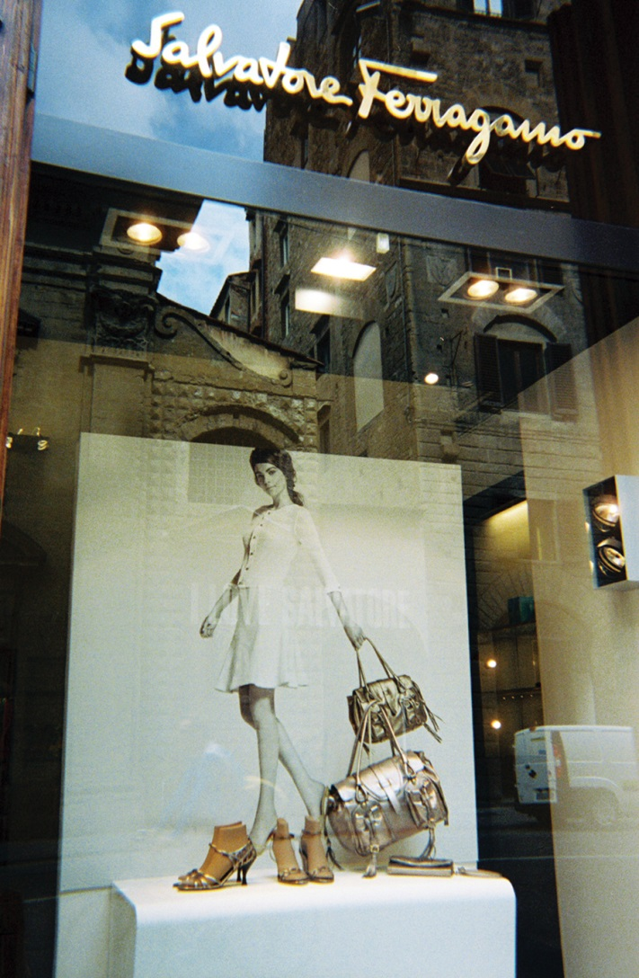
Achieved Status: Class (2 of 2)
Notes:
Salvatore Ferragamo headquarters in Firenze (Florence), Italy. Top brand names such as Ferragamo are highly sought after by consumers internationally who can afford to buy these luxury goods.

Slide 28
Ascribed Status: “Race,” Ethnicity, Gender, and Caste (1 of 5)
Systems of social stratification based on divisions of people into unequally ranked groups
Each system has local features
  Example: Central and South America, the concept of mestizaje: “racial” mixture
Must know the local system of categories to understand the dynamics of inequality that go with them

Slide 29
Ascribed Status: “Race,” Ethnicity, Gender, and Caste (2 of 5)
“Race”
  Recent form (past few centuries) of social inequality
  Unequal meeting of two formerly separate groups through colonization, slavery, and other large-group movements
  Not a biological reality
  Example: apartheid in South Africa

Slide 30
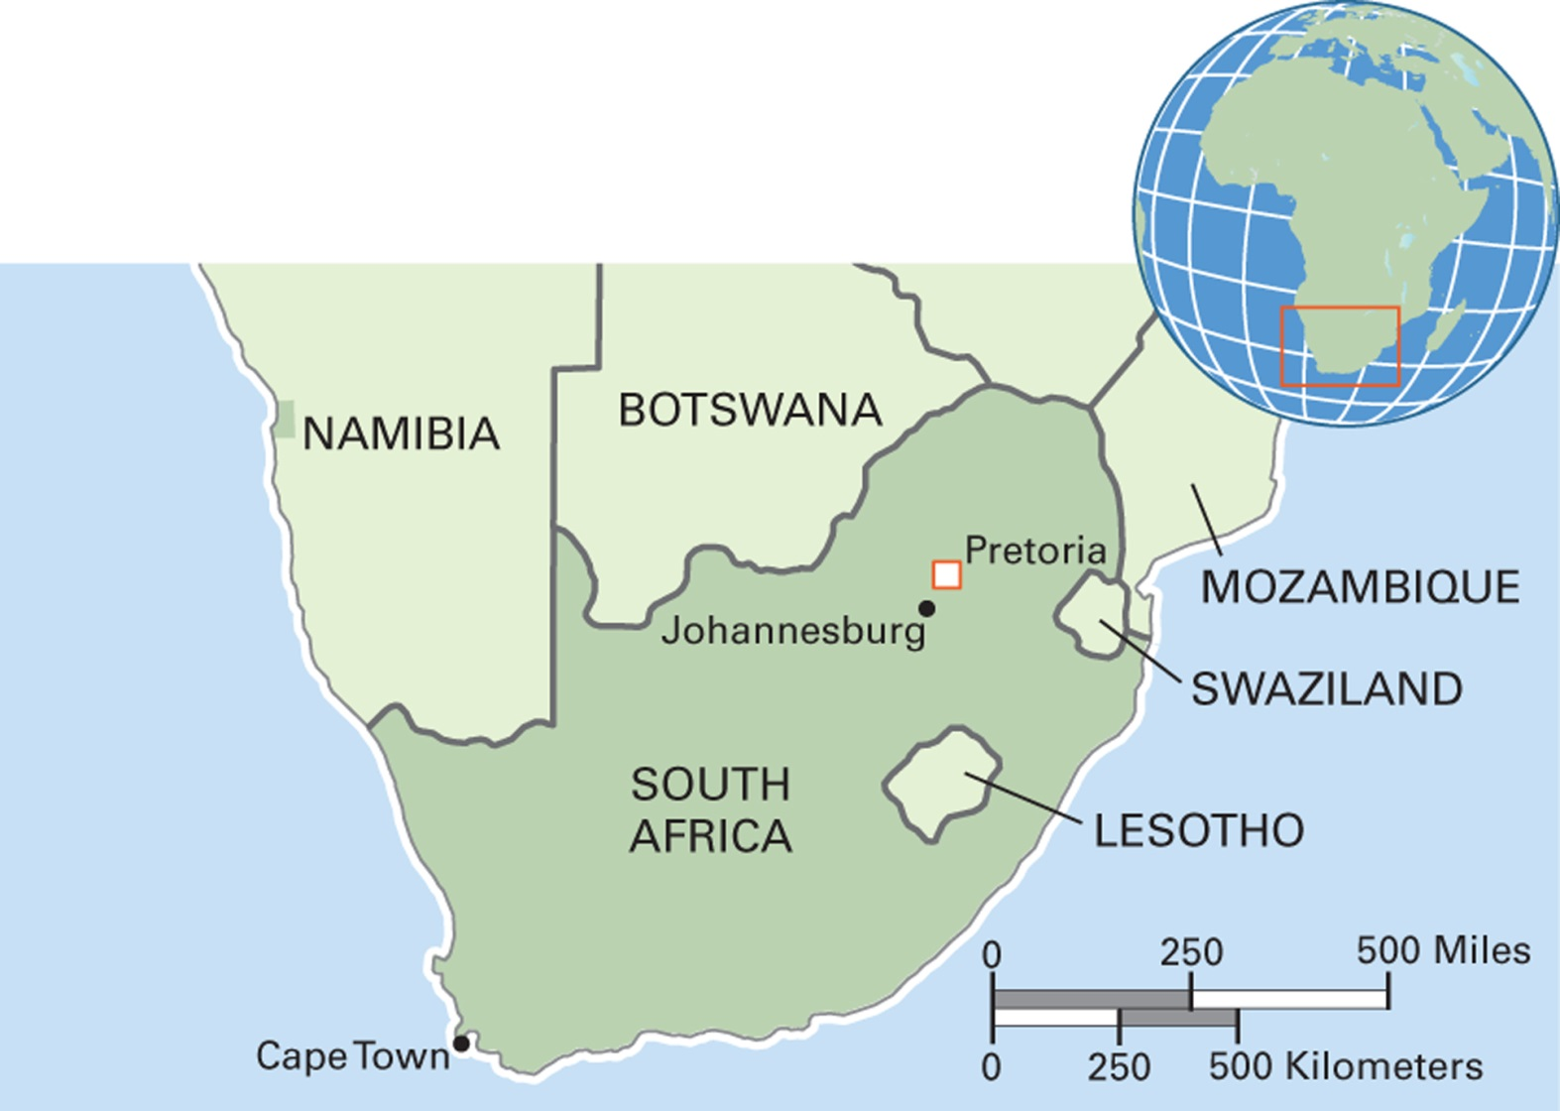
Map 9.5 South Africa
Notes:
The Republic of South Africa experienced the highest level of colonial immigration of any African country. Its rich mineral wealth attracted interest from global powers throughout the Cold War era. Of its population of 52 million, 80 percent are Black South Africans. The rest are of mixed ethnic backgrounds and referred to as “Coloureds,” Indian (from India), or White, who are mainly descendants of colonial immigrants. South Africa has 11 official languages, and it recognizes eight nonofficial languages. Afrikaans and English are the major languages of the administration. Nonofficial languages include those of the San and other indigenous peoples.

Slide 31
Ascribed Status: “Race,” Ethnicity, Gender, and Caste (3 of 5)
Ethnicity
  Sense of group membership based on a shared sense of identity
    Shared history
    Territory
    Language
    Religion
    Combination of the above
  Diaspora population: a dispersed group living outside their original homeland

Slide 32
Ascribed Status: “Race,” Ethnicity, Gender, and Caste (4 of 5)
Caste
  Social stratification system linked with Hinduism
  Based on a person’s birth into a particular group
  Varnas: four major social categories
    Brahmans, priests
    Kshatriyas, warriors
    Vaishyas, merchants
    Shudras, laborers
  Dalits (“untouchables”) considered lower status than those within varnas

Slide 33
Ascribed Status: “Race,” Ethnicity, Gender, and Caste (5 of 5)
Caste system maintained through:
  Marriage rules
    Jati endogamy (in-group marriage)
  Spatial segregation
  Rituals
Indian constitution of 1949 declared discrimination based on caste illegal
  Equality increasing, especially since the late twentieth century

Slide 34
Culturama: The Roma of Eastern Europe (1 of 2)
Also known by the derogatory term “Gypsies”
Europe’s largest minority population (7 to 9 million)
Roma are 10 percent of the population of Eastern Europe
History of mobility and marginality
Settled Roma live in marginalized areas that lack decent housing

Slide 35
Culturama: The Roma of Eastern Europe (2 of 2)
In different countries, the status and living conditions of Roma vary
  Situation in Slovakia is among the worst
    One-third of Roma live in osada, ghetto-like enclaves with poor housing, sanitation, and schools
  Conditions for the Roma are improving in Hungary since it joined the European Union in 2004

Slide 36
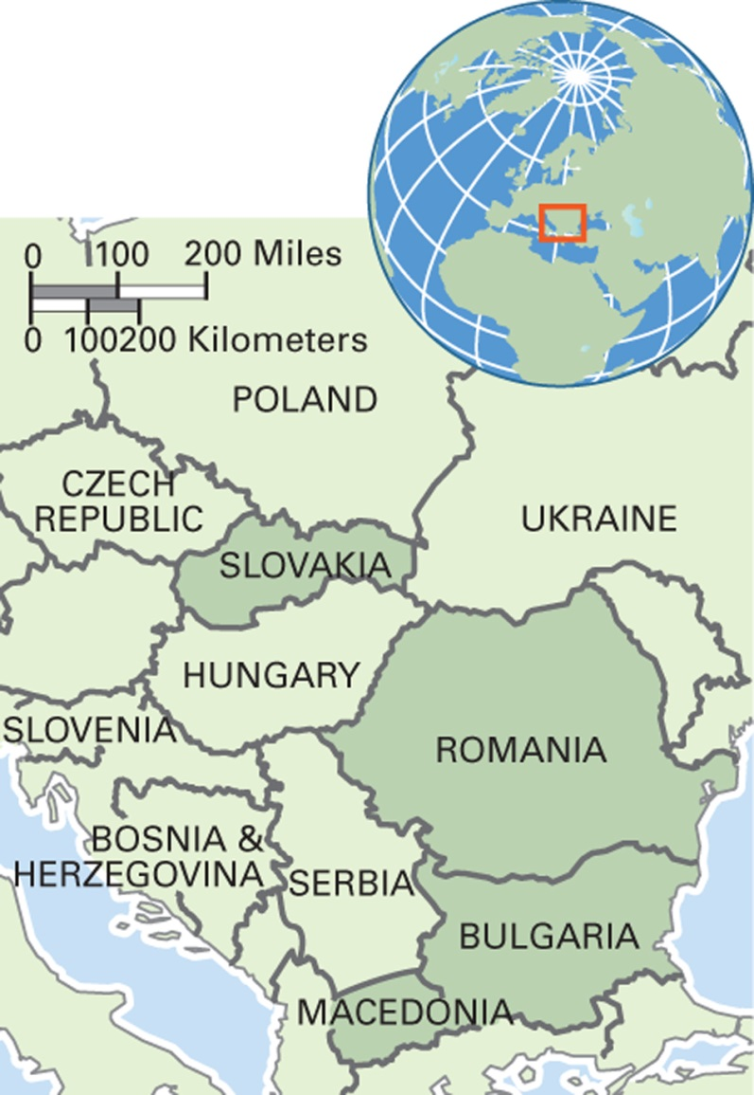
Map 9.6 Roma Population in Eastern Europe
Notes:
Romania has the highest number of Roma of any country in the world, between one and two million. Macedonia has the highest percentage of Roma in its population.

Slide 37
Civil Society (1 of 2)
9.3 Discuss the concept of civil society.
Civil Society for the State: The Chinese Women’s Movement
Activist Groups: CO-MADRES
Social Capital, Social Movements, and Social Media

Slide 38
Civil Society (2 of 2)
Civil society: interest groups that function outside the government to organize economic and other aspects of life
  Can be divided into those that support the state and those that oppose it (Gramsci)

Slide 39
Civil Society for the State:
The Chinese Women’s Movement
Works in support of government policy goals
  Improvement of women’s lives
Research conducted by Ellen Judd
  Closely monitored by the state
  Found benefits from the group’s work in education, employment for women
Chinese women’s movement controlled by the state
  Truly an example of civil society?

Slide 40
Activist Groups: CO-MADRES
Activist groups
  Formed with the goal of changing certain conditions
Example: CO-MADRES
  Formed to hold Salvadoran government responsible for abductions and deaths during and after the civil war
  Also works against domestic violence and for political education for women

Slide 41
Social Capital, Social Movements, and Social Media
Social capital: the intangible resources existing in social ties, trust, and cooperation
New social movements: social activist groups that emerged in late twentieth century
  Many examples of groups formed by oppressed minorities: indigenous groups, ethnic groups, women, and the poor
  Use of social media

